Slide 1
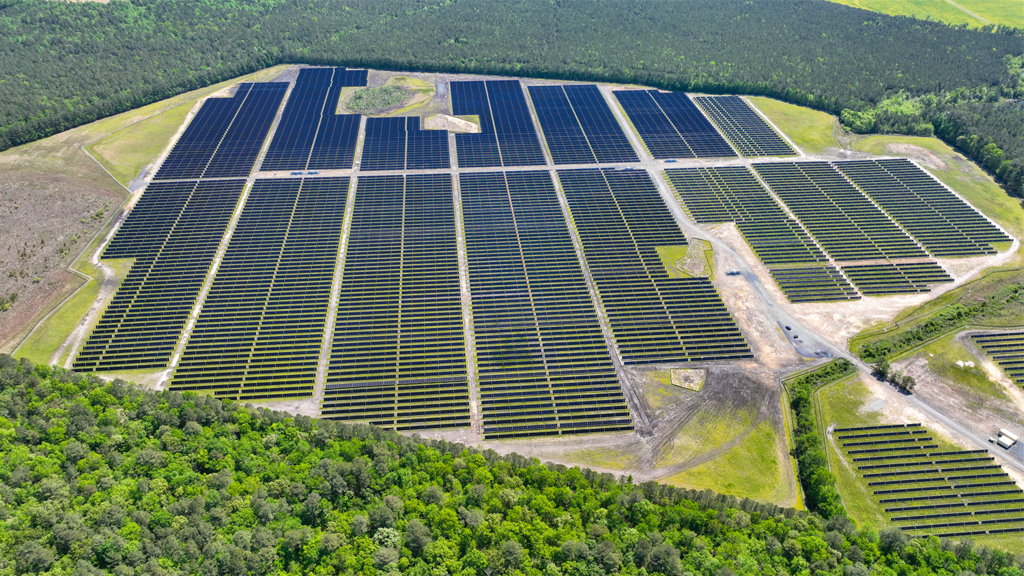
Town Line Solar: Your Partner in Providing Reliable, Affordable Electricity
in Sullivan County, N.Y.

Slide 2
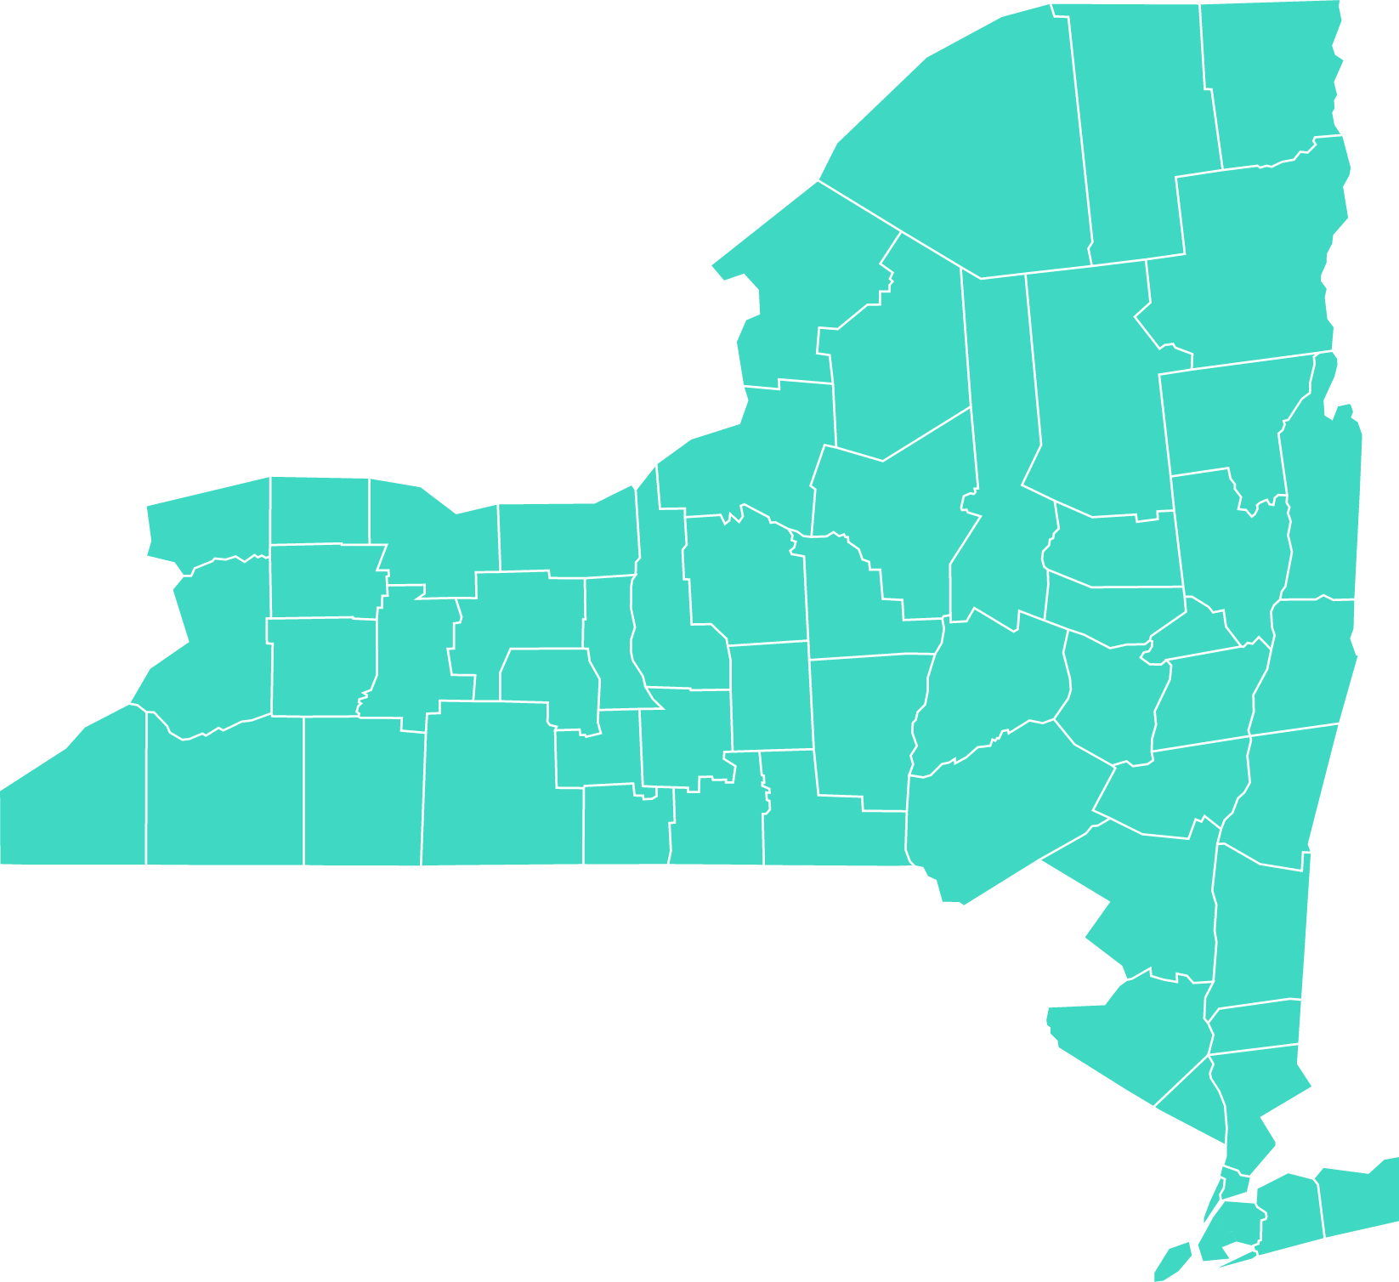
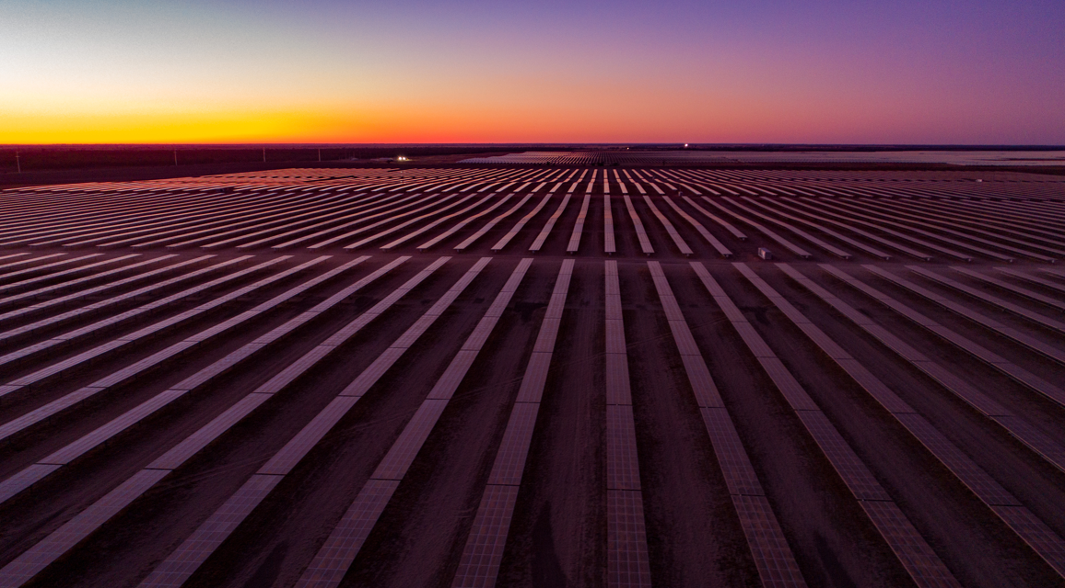
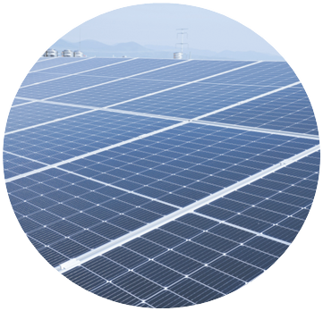
RWE in New York
In Operations
Baron Winds 1 (Stueben County)
Baron Winds 2 (Steuben County) starting construction
Cassadaga Winds (Chautauqua County)
Munnsville Wind (Madison County)
Stillwater Storage (Saratoga County)
404 total MWacs, enough to power over 115,000 homes with clean energy.
Project Pipeline
Pipeline totaling over 1800 MWacs, operational by end of 2029
Over 900 MWacs in Solar and 800 MWacs in Storage

Slide 3

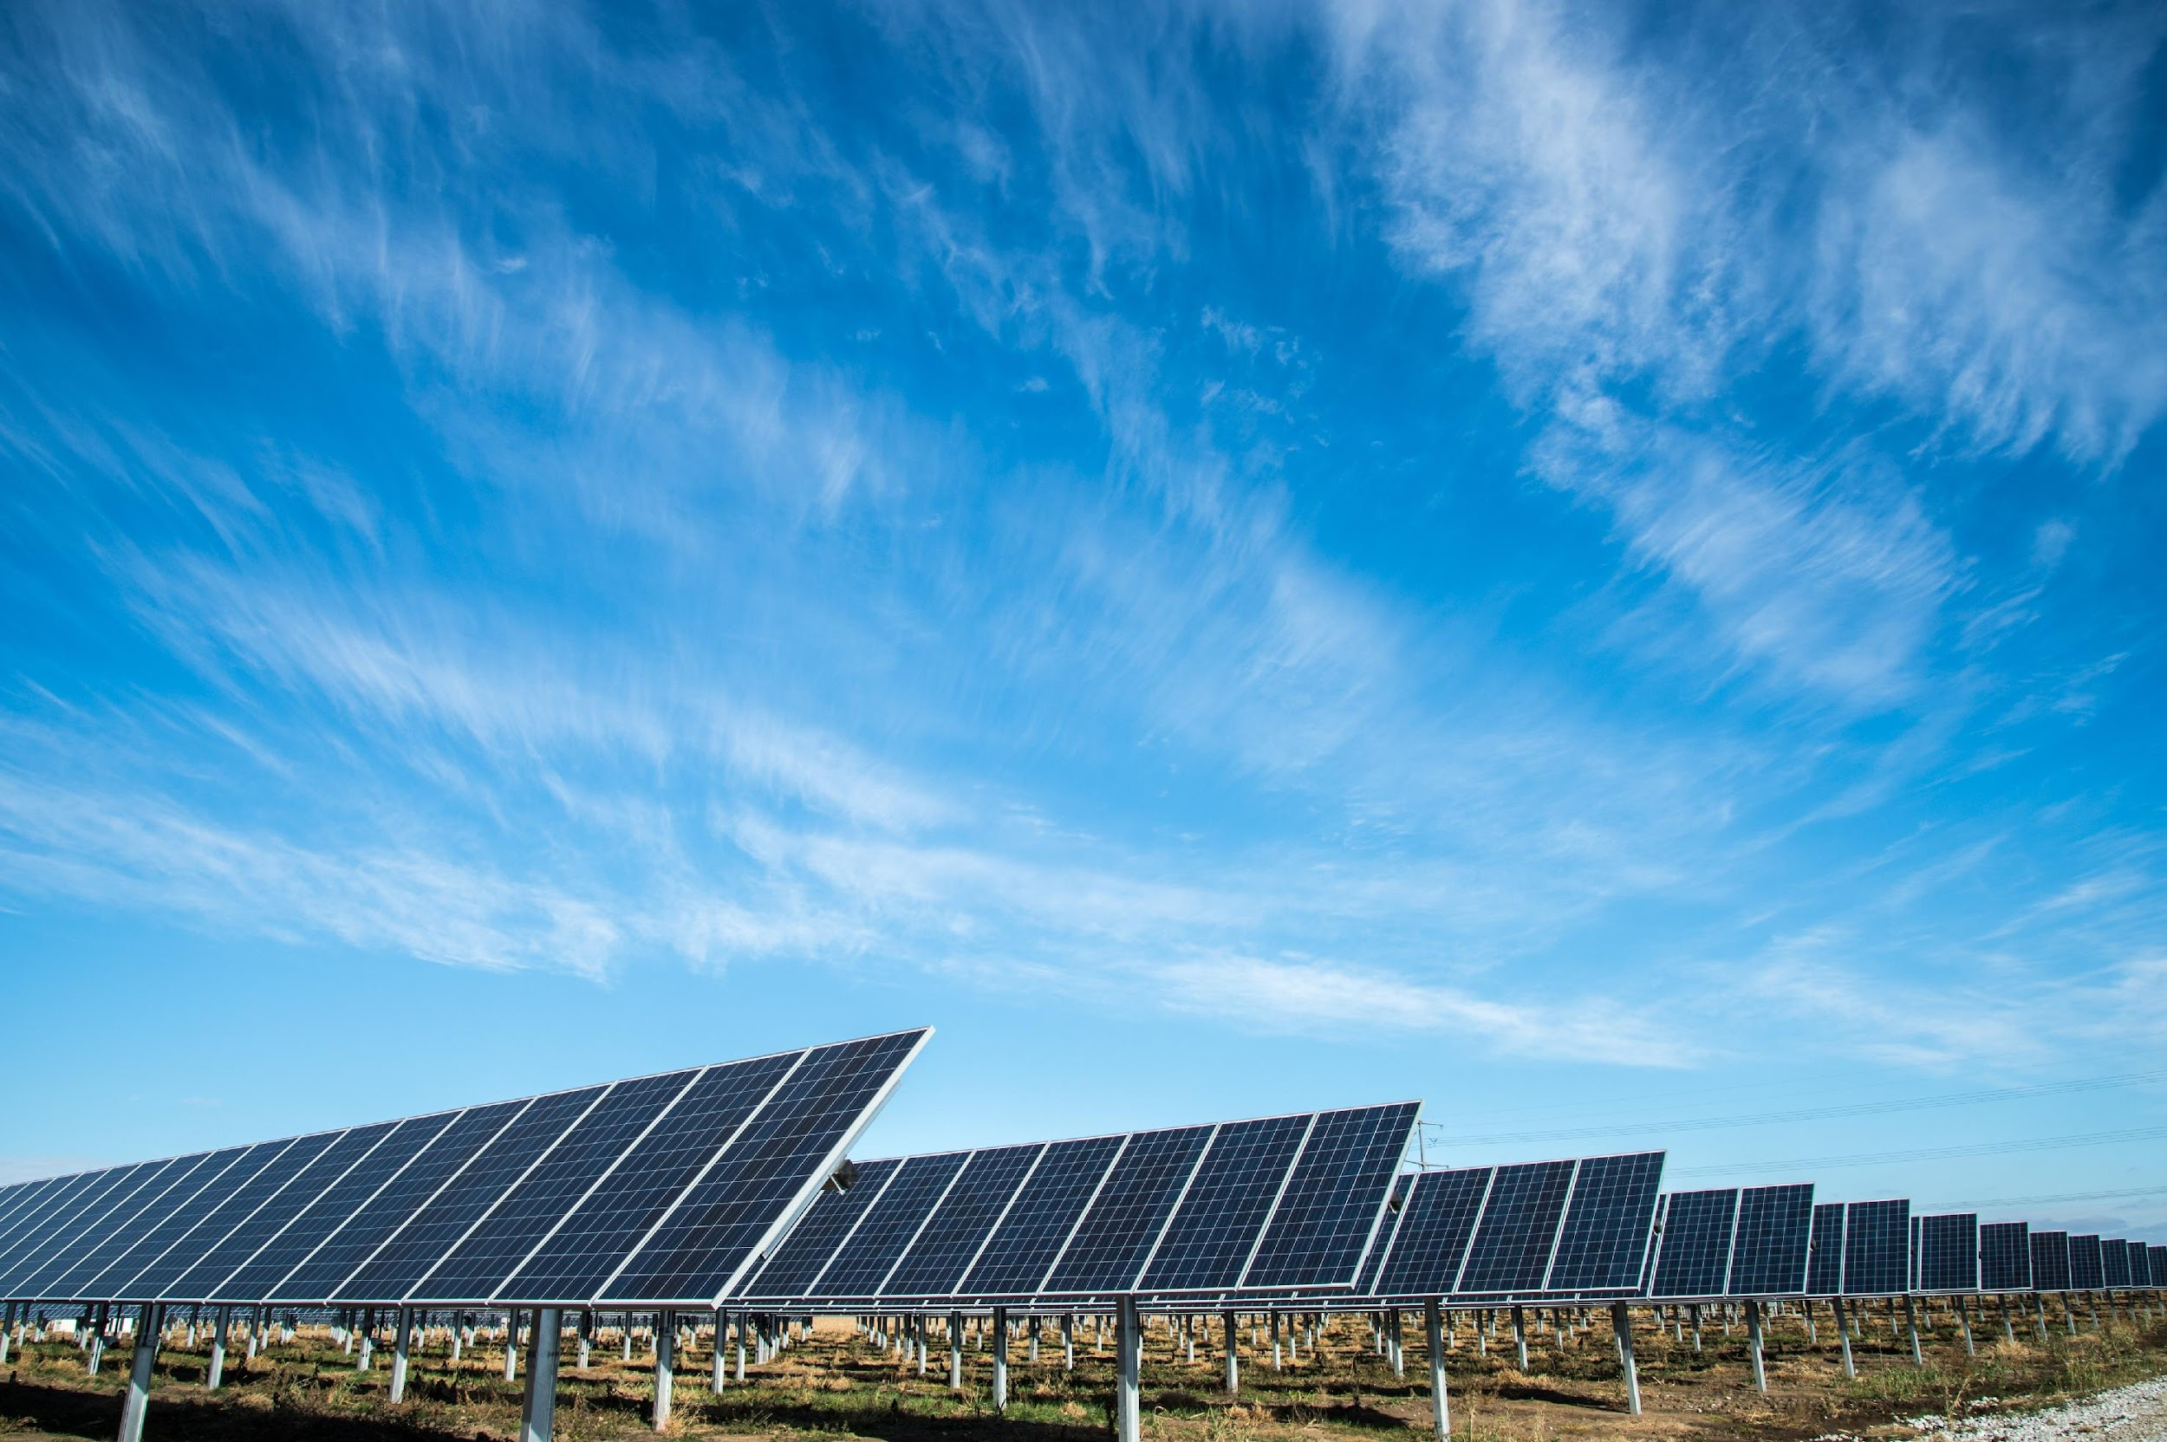

Your Local Project | Sullivan County, N.Y.
Town Line Solar
200 mWac Solar
A 200 megawatt solar farm on 1,100 acres
100 mWac / 400 mWh’s Energy Storage
100 megawatts -- enough to store 400 megawatt hours -- Battery Energy Storage System on about five acres
26,961 Homes
Generating enough clean electricity to power 26,961 homes

Slide 4
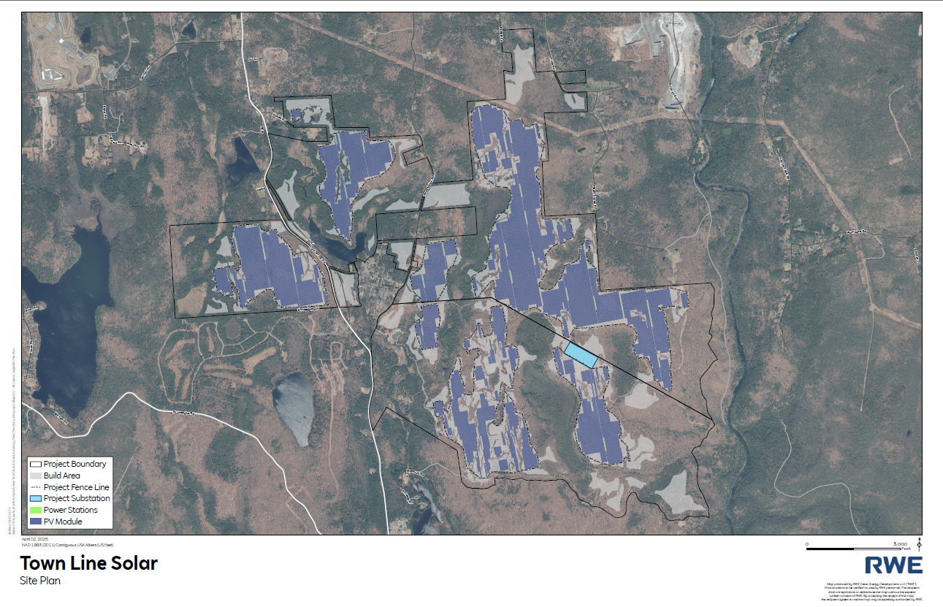

Slide 5
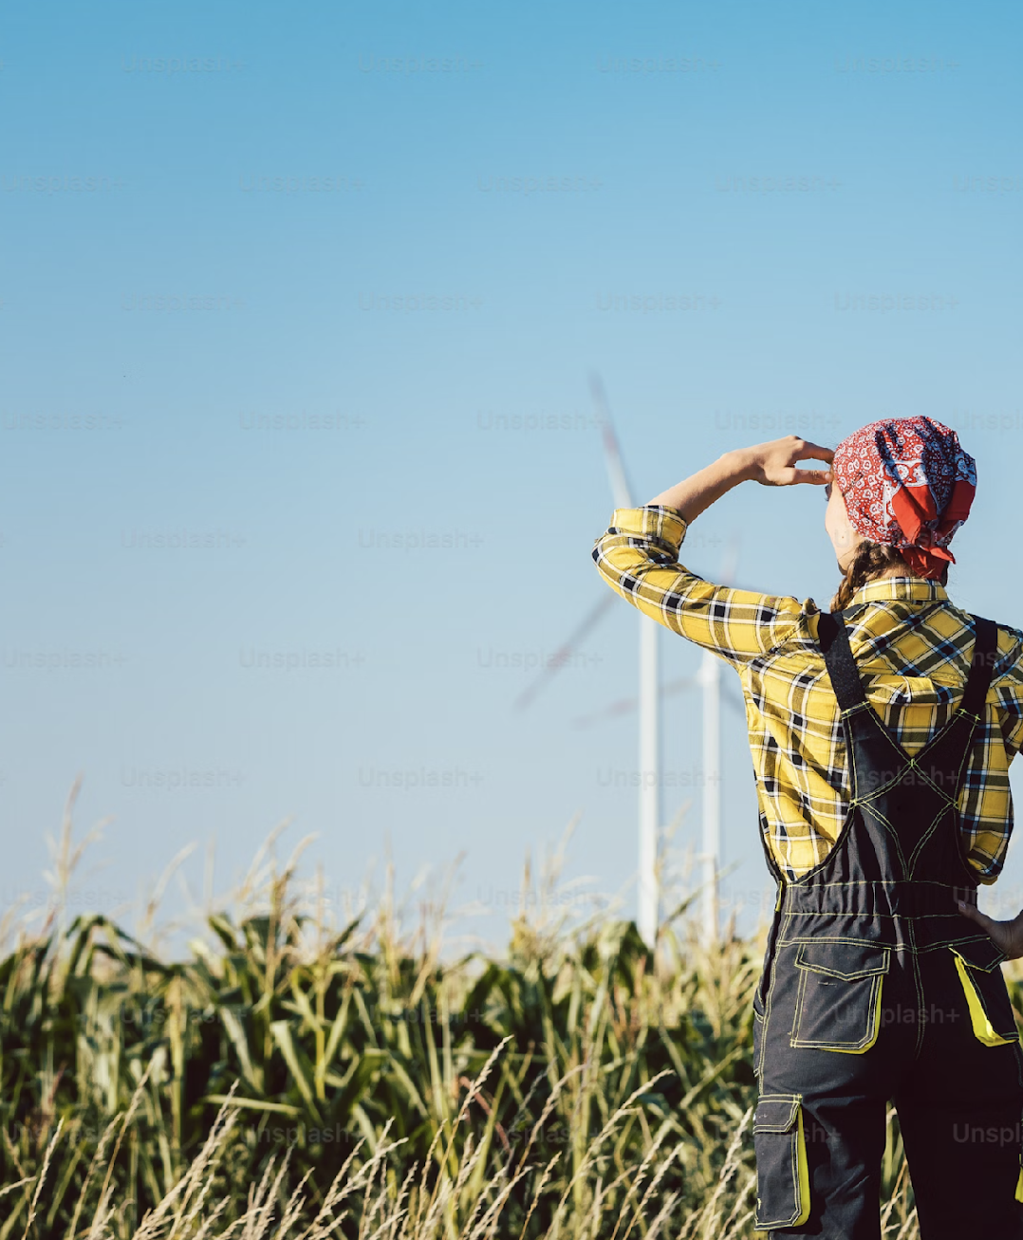
Project Benefits
$900,000
Proposed Year 1 PILOT Payment
Economic Benefits brought by Town Line Solar to Sullivan County & the Towns of Forestburgh & Thompson:
3 - 6 full time operations employees
311 construction jobs
$34,150,700 in construction earnings that could circulate in local economy
$21,867,632.82
Total PILOT Payments over 20 years

Slide 6

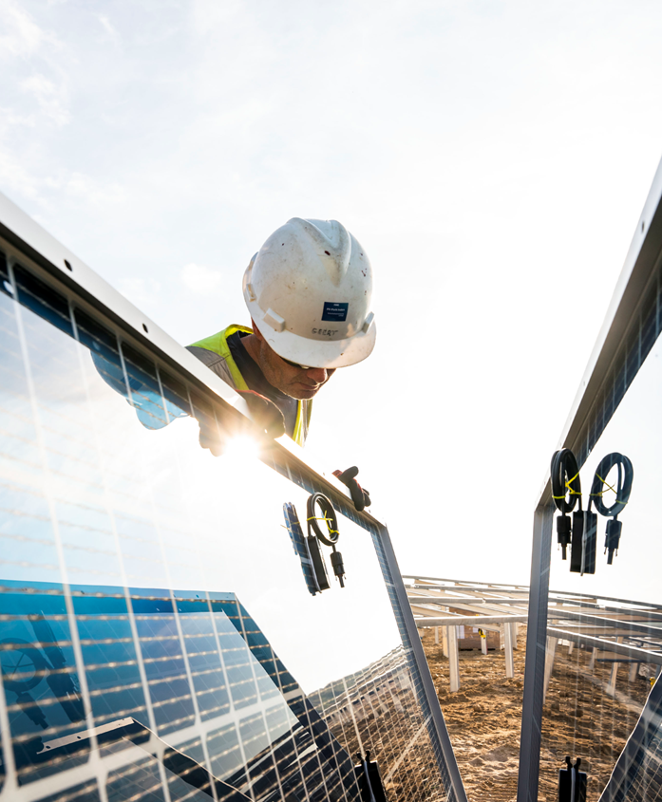
Review Pathway
The proposal will undergo permitting review by the New York State Office of Renewable Energy Siting (ORES).
Town Line Solar looks forward to continuing substantial local agency, community, and stakeholder engagement, which began in 2023 and will continue throughout the permitting process and development of the project.

Slide 7
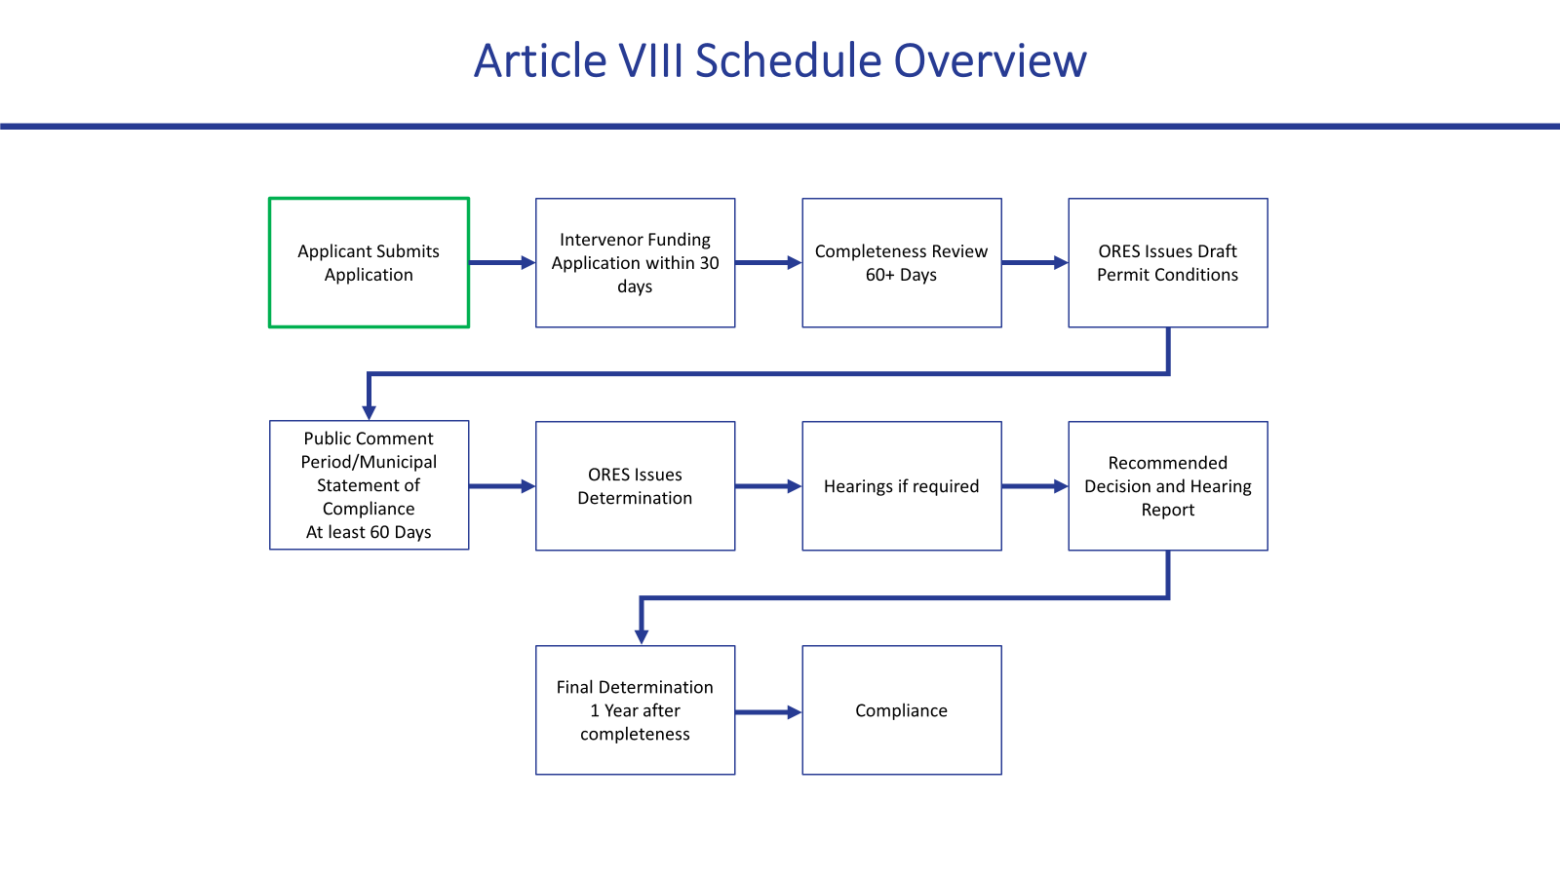

Slide 8
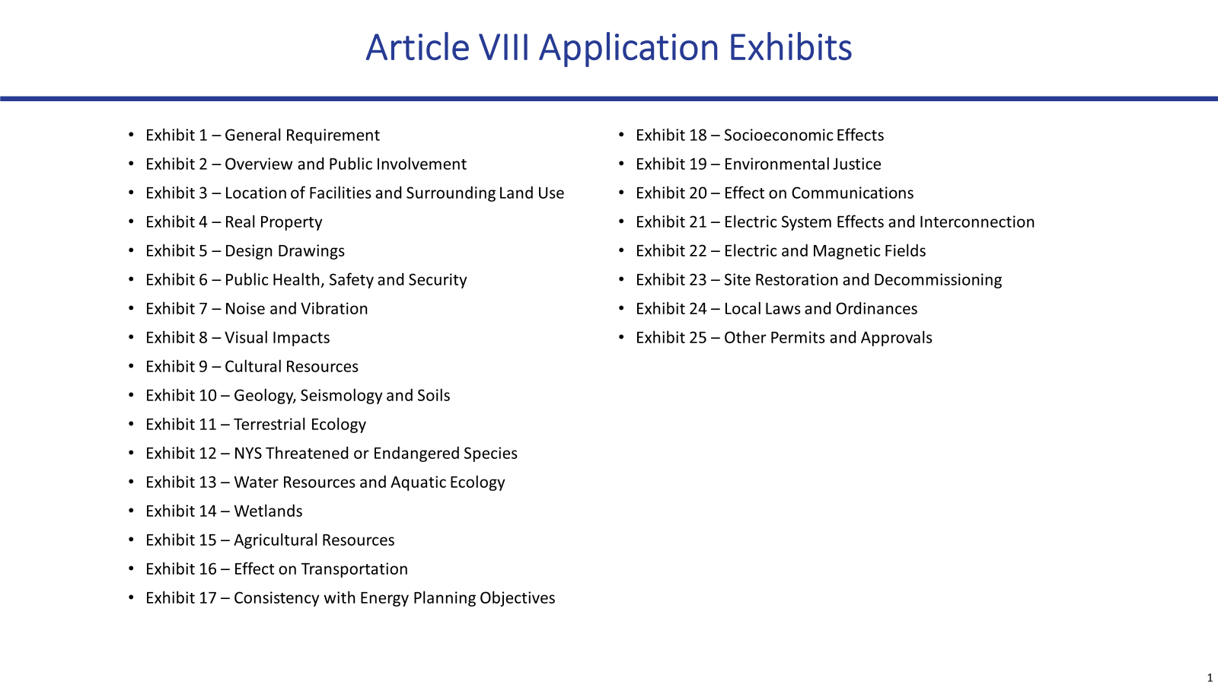

Slide 9
Your Local Project | Sullivan County, N.Y.
Town Line Solar & Storage Timeline
1
2
3
4
Q3 2025
Q3 2026
Q3 2027
Q4 2028
Expected Final Permit issued by ORES
Anticipated
start of construction
Anticipated
start of operations
Application submission

Slide 10
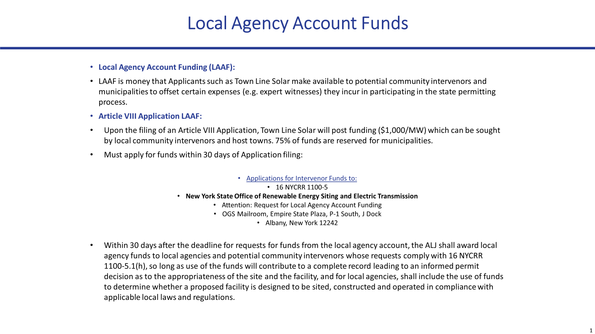

Slide 11
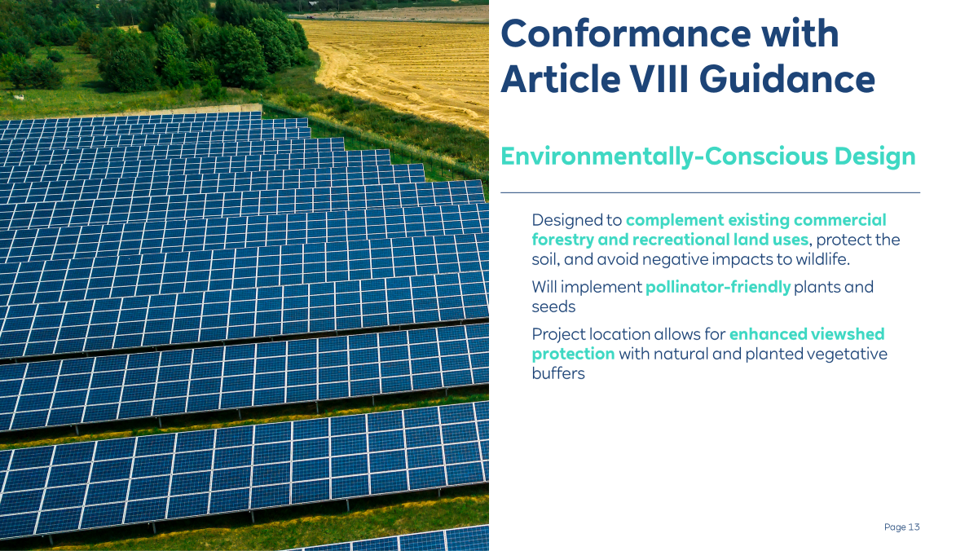

Slide 12
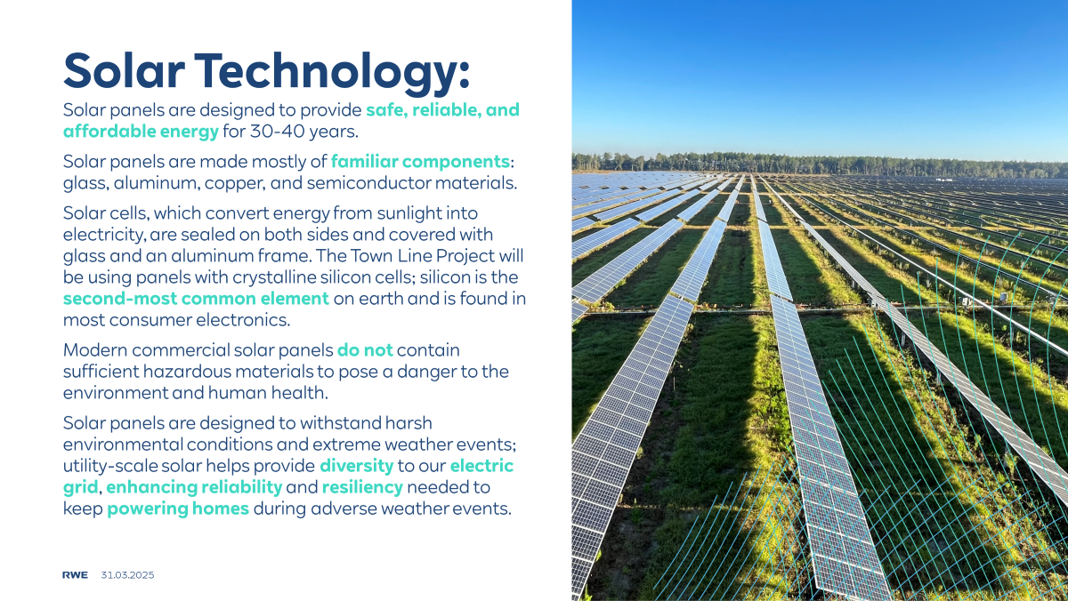
Solar Energy
RWE uses solar energy to make electricity more affordable while reducing land impact.
A solar panel is made of a thin solar cell, usually made of silicon, encased in a sturdy glass and a hermetically sealed metal frame to optimize performance and prevent environmental externalities. Energy from sunlight is absorbed by the solar cells and transformed into electricity. This electricity flows through inverters and transformers before being sent to a substation and to the power grid.

Slide 13
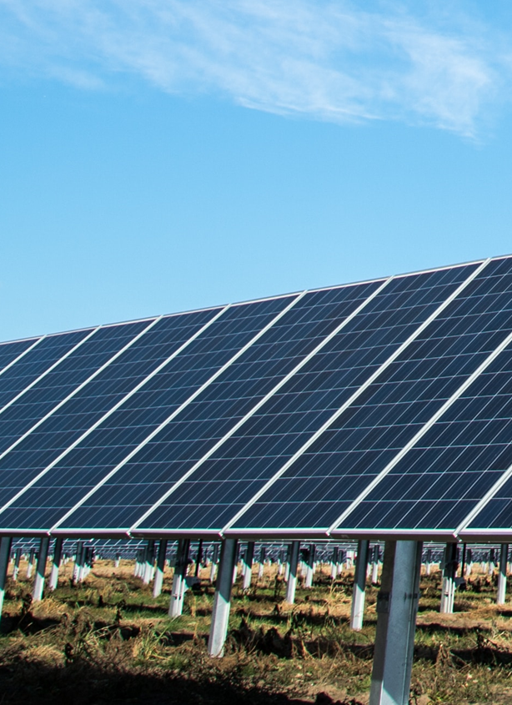
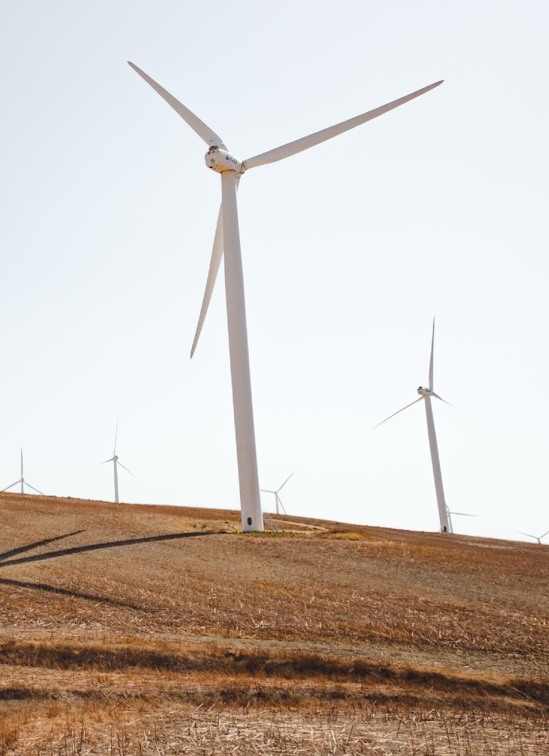
Benefits of Solar
Solar energy is just as — or even more — dependable than other forms of energy.
Each kilowatt-hour (kWh) of solar generated substantially reduces pollution such as greenhouse gas emissions that include carbon dioxide, sulfur oxides, nitrogen oxides and particulates.• No fuel is burned and no water is used, preserving natural resources.
• Helps protect people, wildlife, natural resources and the environment.
Reduced dependence on fossil fuels advances energy self-sufficiency.
Reliability Is Critical
No fuel is burned and no water is used, preserving natural resources
With turbines, panels and batteries spread out geographically over a large, interconnected grid, local weather patterns have less impact on the overall grid.
RWE remotely monitors all of our solar projects 24/7, while an on-site team conducts routine maintenance and is ready to respond immediately to any needs.

Slide 14
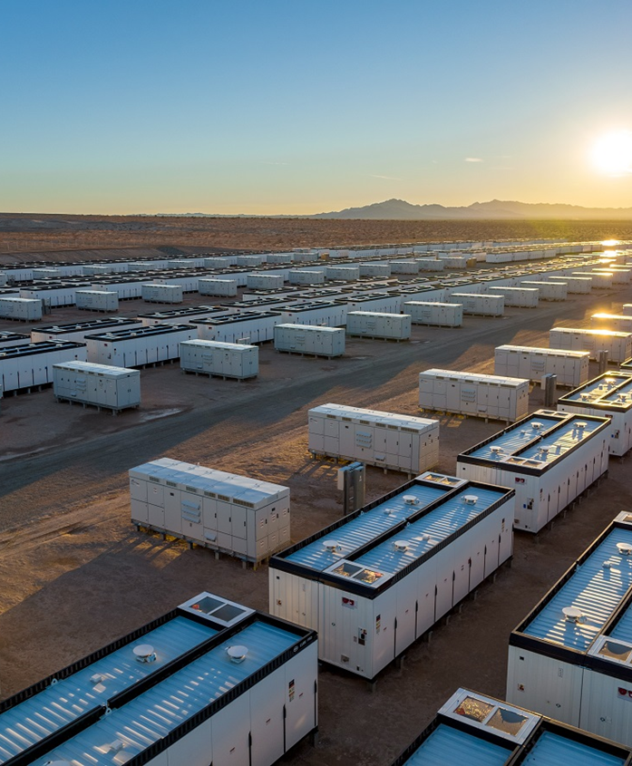
Battery Energy Storage Systems
RWE’s BESS units help optimize energy usage and better ensure that electricity supply meets demand.
Batteries store energy when prices are low or there is surplus energy on the grid. • Helps protect people, wildlife, natural resources and the environment.
Batteries discharge power to the grid when prices are high, there is an energy shortage on the grid, or the grid requires energy to ensure smooth operations.
Reliability Is Critical
Systems provide reliable instantaneous power during peak power demands, preventing brown/blackouts.
With turbines, panels and batteries spread out geographically over a large, interconnected grid, local weather patterns have less impact on the overall grid.
BESS enclosures are approximately 8 feet tall, 8 feet wide and
20 feet long. They’re sealed within watertight layered steel
and maintained at a safe operating temperature.

Slide 15
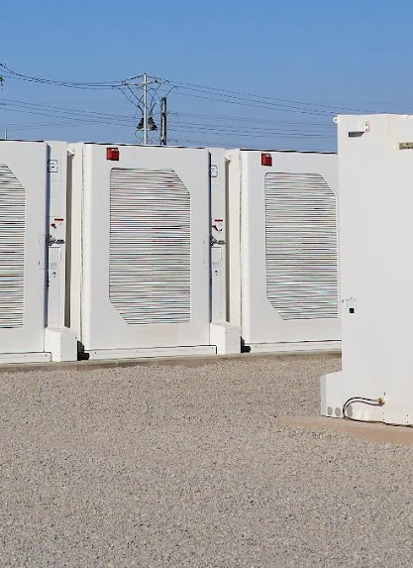
Battery Energy Storage System Benefits
Storing energy from solar is safe and environmentally sound.
Modernizing power grids by providing flexibility, reliability and improved integration of renewable energy resources.
.
Reduced need for power lines and poles.
Built in resiliency and protection as consumer and business power demands increase.
No additional community traffic.
10 Years of Safety
RWE has a track record of more than a decade in building, operating and maintaining safe energy storage facilities.
No emissions or pollutants, benefiting public health.

Slide 16
Why New York State Seeks BESS Systems
Battery energy storage is just as — or even more — dependable than other forms of energy and is gaining widespread use.
Battery systems help stabilize New York State’s power supply and gradually decrease the burning of fossil fuels.
The State’s focus on renewable energy includes the goal of having 6 gigawatts of energy storage by 2030.
Reliability Is Critical
With solar and battery energy storage systems spread out geographically over a large, interconnected grid, local weather patterns have less impact on the overall grid.
Town Line’s BESS component will help meet increasing energy demand in New York State.

Slide 17
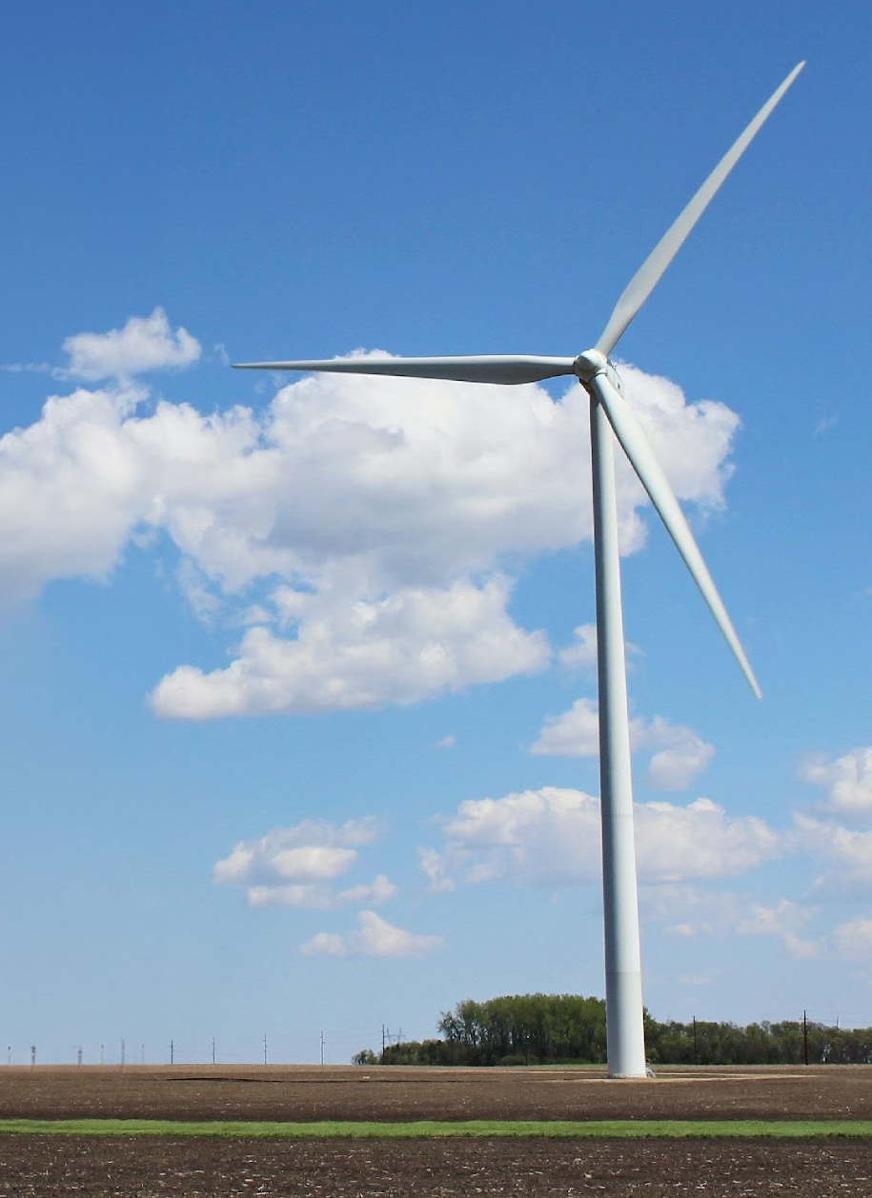
Safety and Health
RWE is a global safety leader at its battery and solar sites with a proud, strong safety record built upon industry-recognized best practices. It places the utmost priority on the health and safety of communities, landowners and workers. RWE also simultaneously prioritizes protection of the environment and natural resources.
Together for a Reliable Grid
Renewable energy is a crucial part of our economy, national energy security, sustainability and health. By reducing harmful pollutants, increasing energy reliability and creating jobs, renewable energy brings benefits to everyone in the United States.

Slide 18
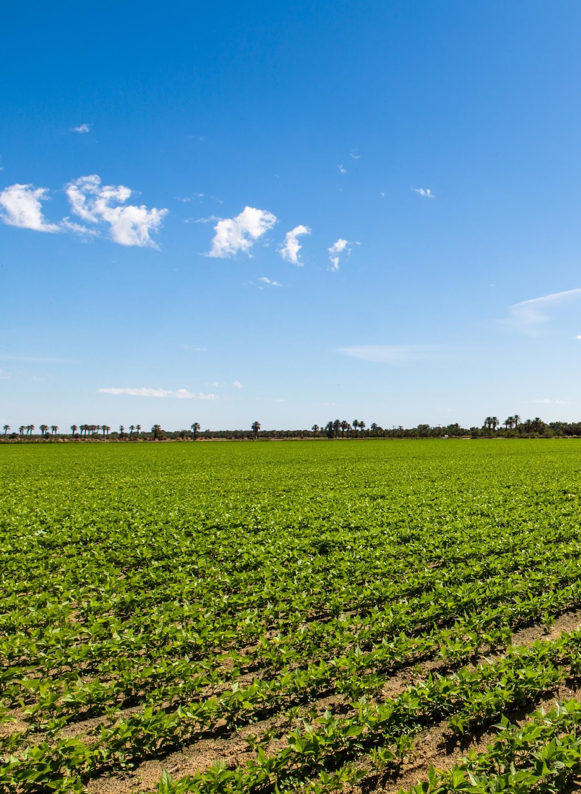
Safety and Health
Safety Points
Safety is RWE’s No. 1 priority, with best practices to protect well-being, the community, environment and natural resources.
Battery storage and solar facilities are safe and comply with all local and state regulations, as well as Underwriter Laboratories, National Electric Code and National Fire Protection Association standards.
RWE will provide training for, and will develop ongoing positive relationships with local fire departments and emergency responders. These organizations will be asked to collaborate on developing safety protocols and a customized emergency response plan.
Extensive fire-detection and fire suppression-systems will be
implemented, with 24/7 monitoring.

Slide 19
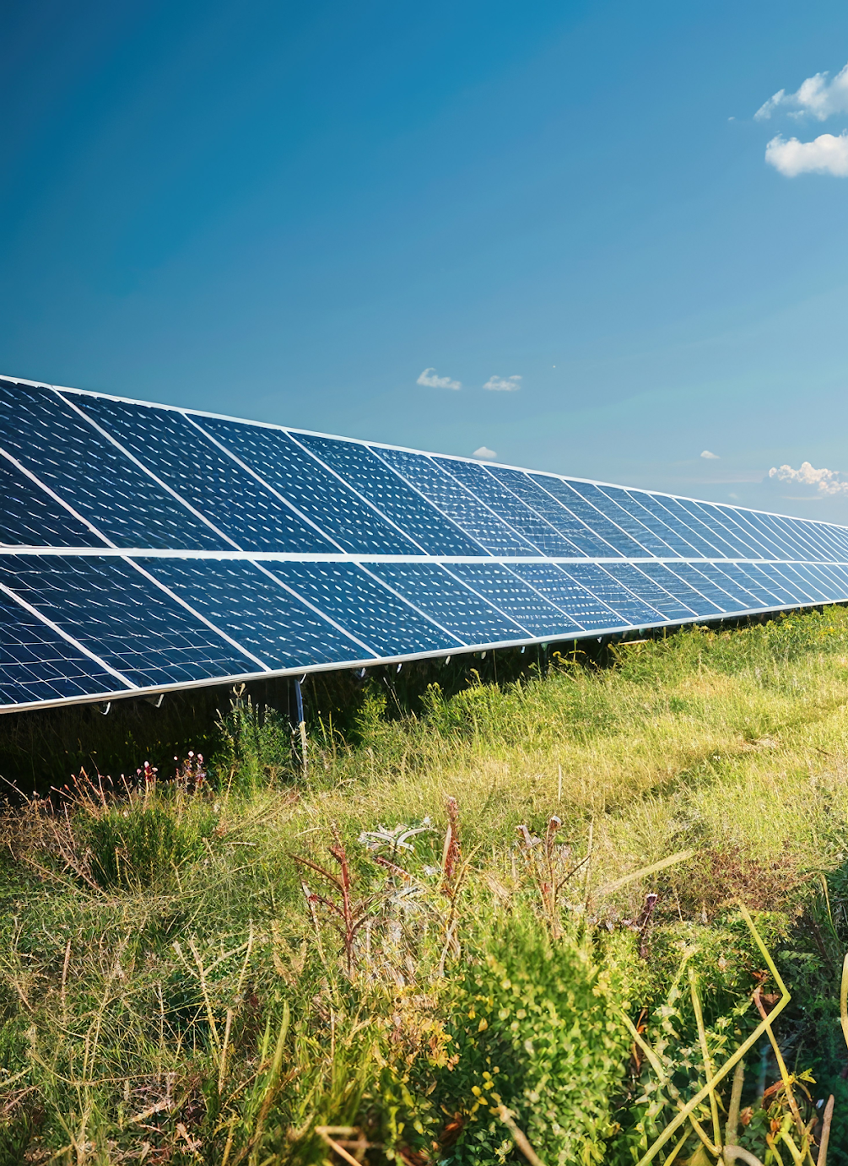
Safety and Health
Battery storage failure rates are extremely rare because cutting-edge safety features reduce the probability of fires.
Safety Points
Smoke from BESS fires shows no notable lasting impacts on the health or safety of first responders or communities.
There is no evidence of potential contaminants associated with fires at BESS facilities migrating into the nearby community.

Slide 20
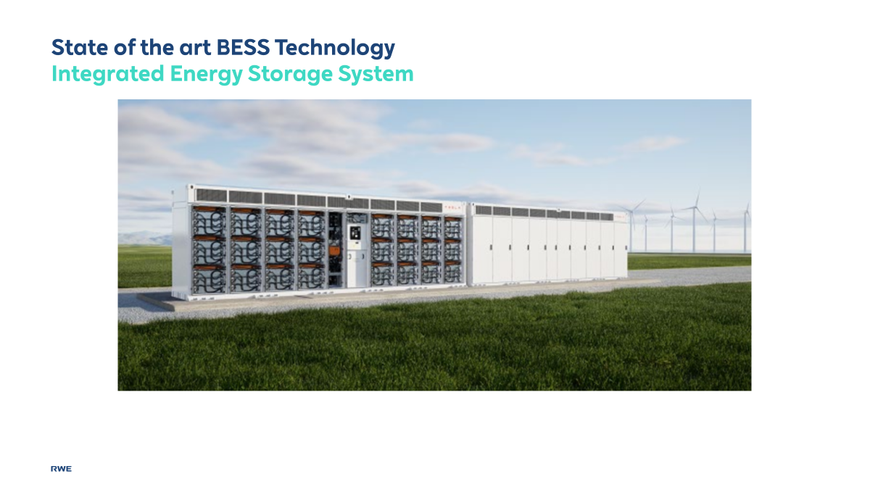

Slide 21
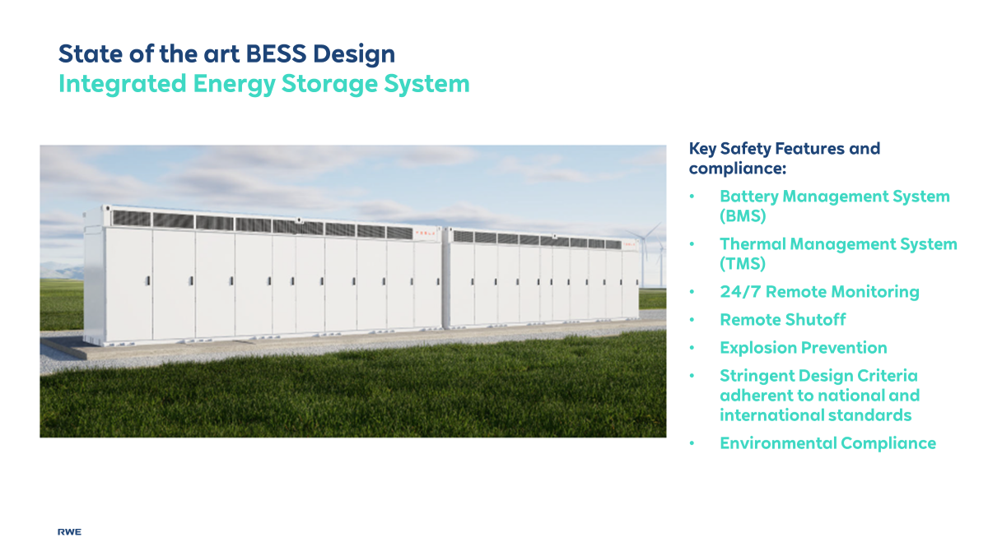

Slide 22
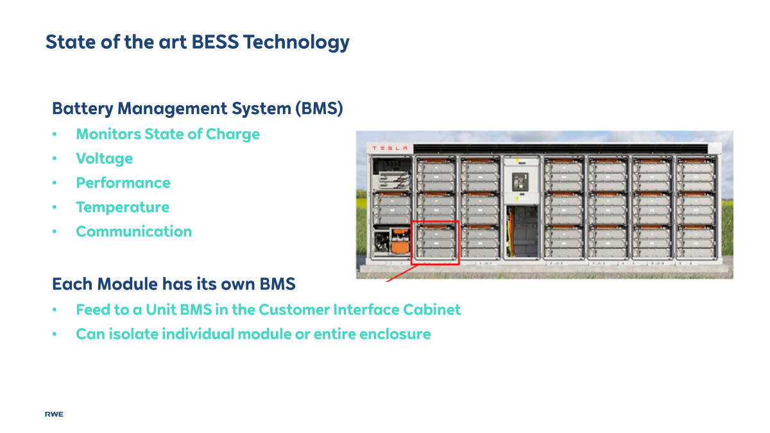

Slide 23
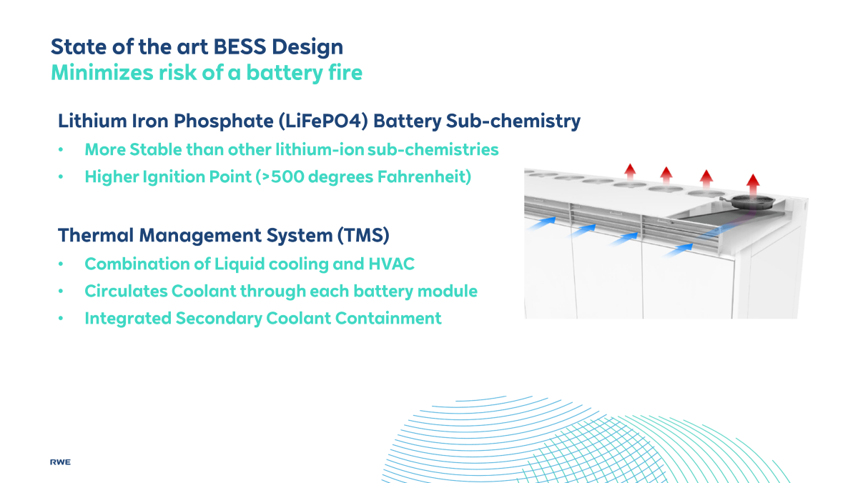

Slide 24
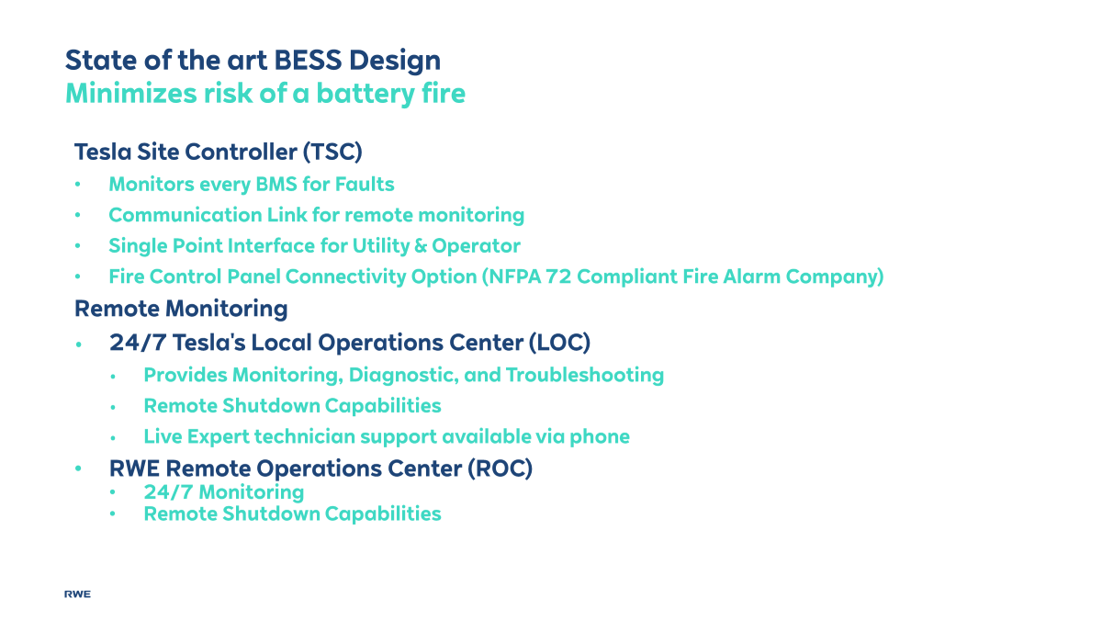

Slide 25
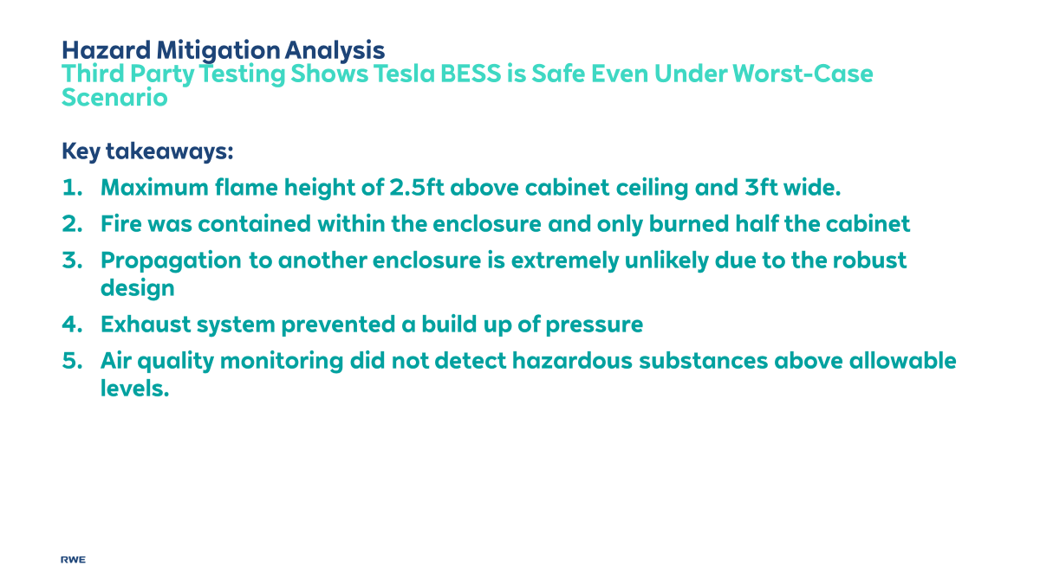

Slide 26
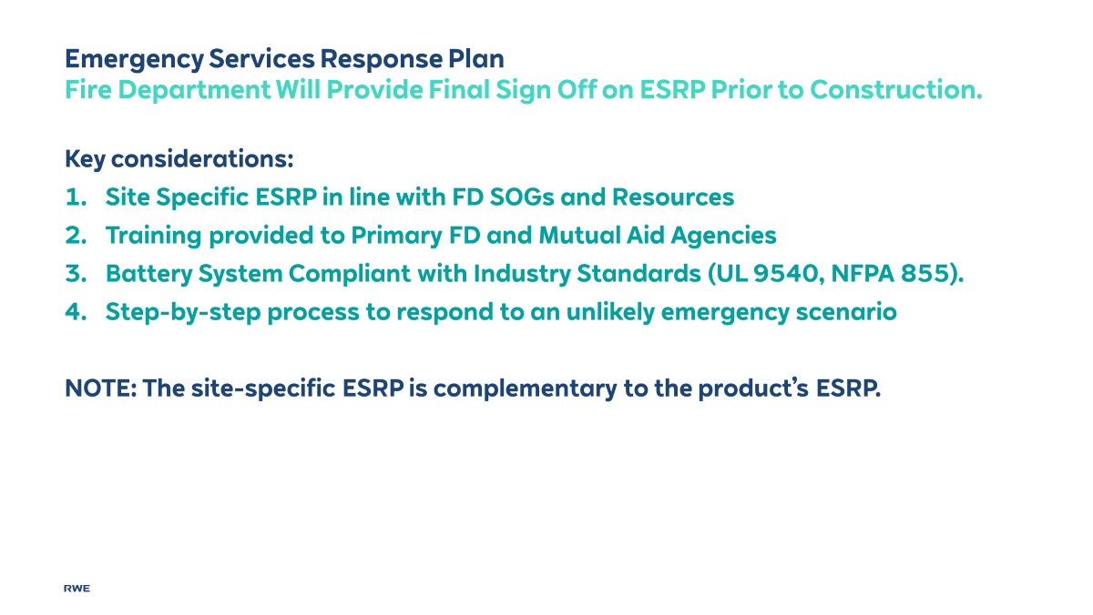

Slide 27
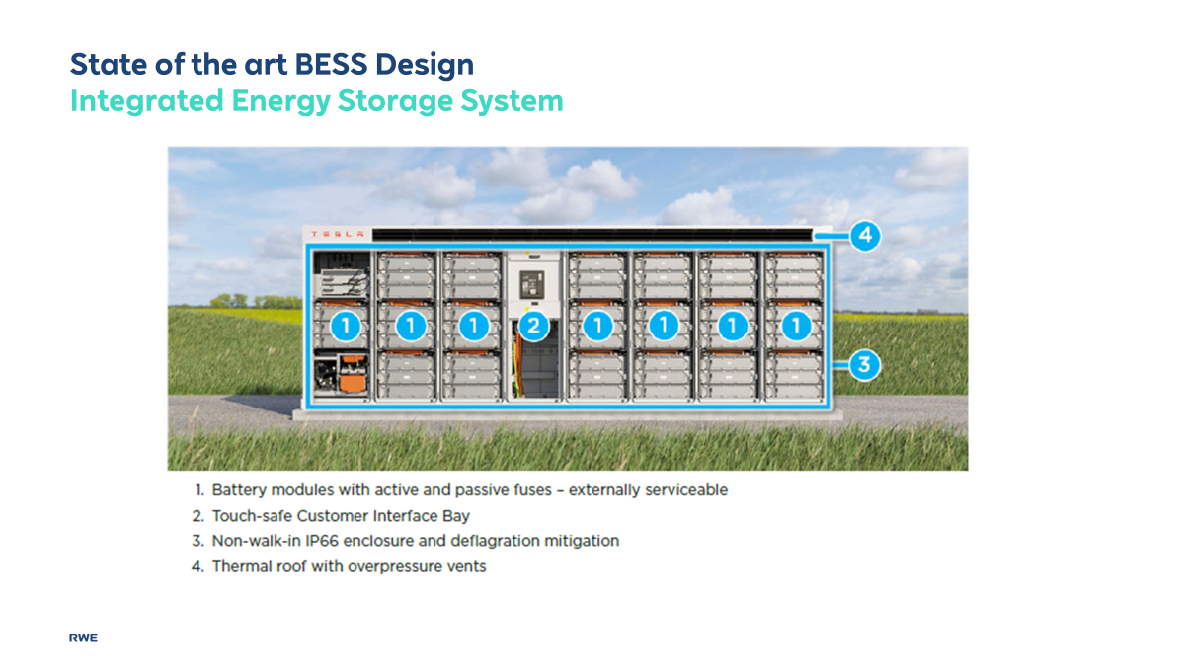

Slide 28
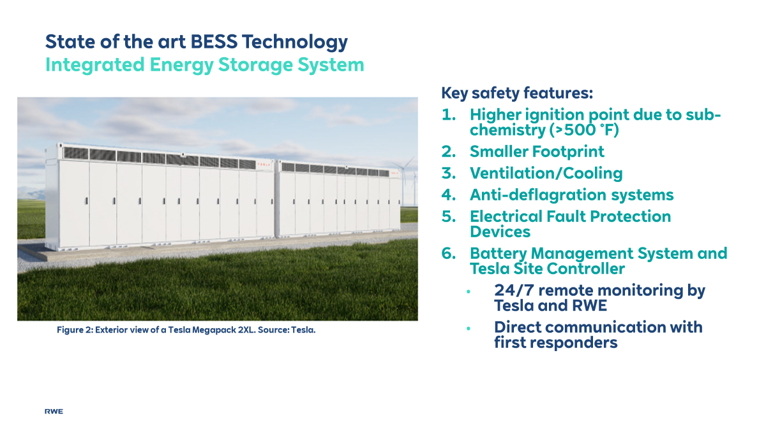

Slide 29
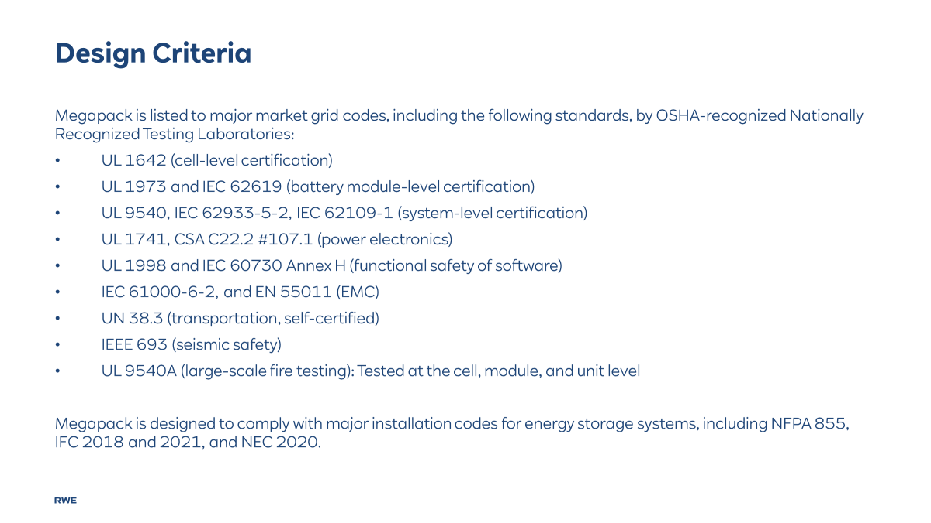

Slide 30
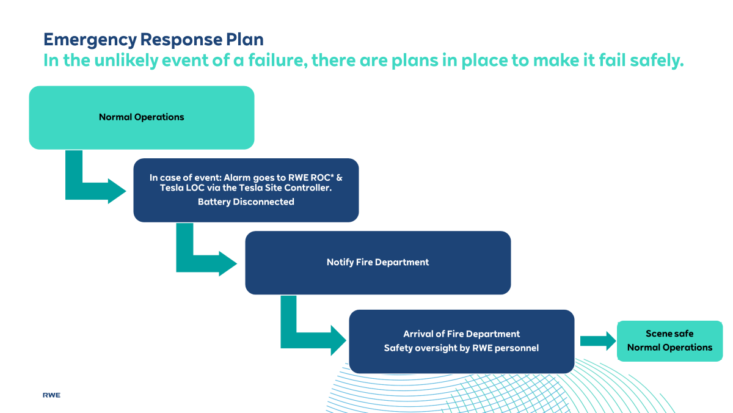

Slide 31
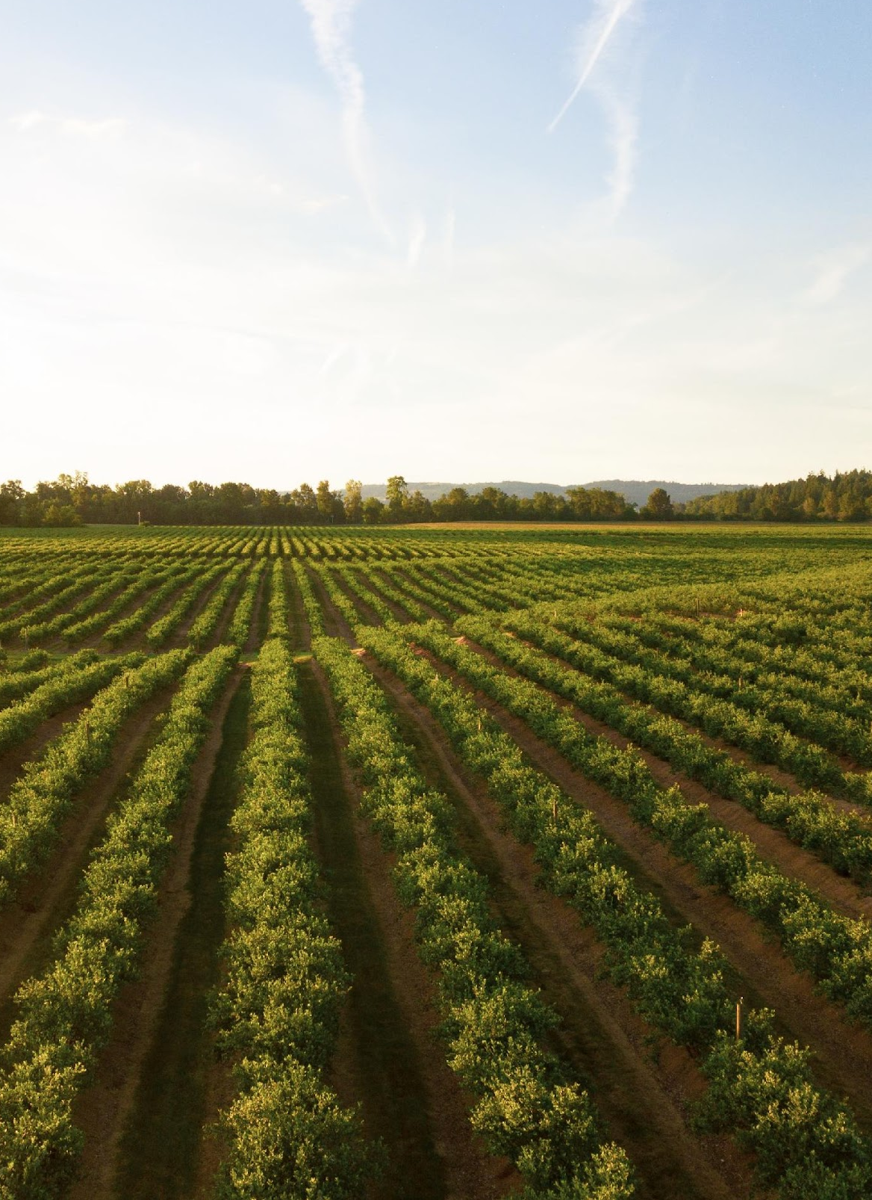
Restoring Land After a Solar Project Ends
Facility decommissioning will be initiated when the facility reaches the end of its operational life. RWE Renewables (the Applicant) will be responsible for the decommissioning of the Facility.
As part of the decommissioning process, the facility site will be restored to pre-construction conditions, including disassembly and removal of above ground structures, removal of subsurface structures to a minimum depth of 36 inches below grade.
The cost of decommissioning will be estimated by a third-party engineer and the estimated net cost amount, plus 15%, is placed as security which towns have access to in the event it is needed. The towns will be consulted on the cost estimate for decommissioning.
The decommissioning and site restoration cost estimate will be updated based on the final as-built project, after 1 year of project operation, and every fifth year thereafter to reflect inflation and any other costs.
The Applicant will provide notice by mail to landowners and the towns of Forestburgh and Thompson prior to commencing decommissioning work.
Giving Solar Panels New Life
Solar panels recommissioned from one project can be refurbished and then reused or resold. There’s also an emerging market for recycling solar panels to get more use out of the materials they’re made from.

Slide 32
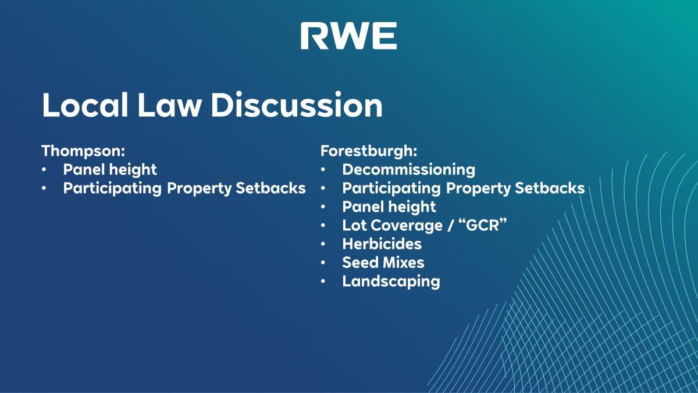

Slide 33
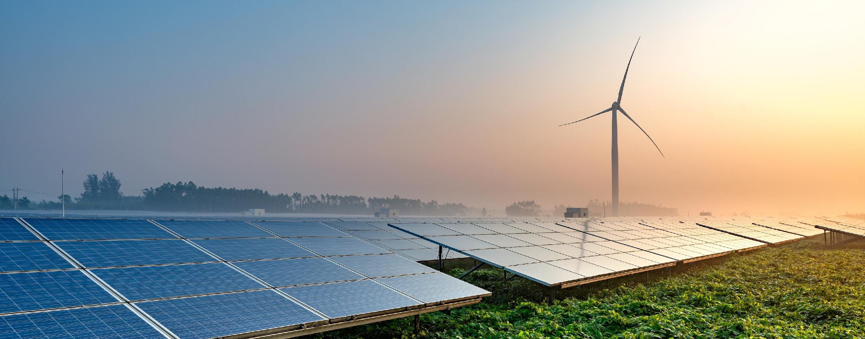
We’re here to help.
Connor Roth
Manager, Utility Scale Development
(512) 975-6597
connor.roth@rwe.com
rwe.com/usa
Tory Kaso
Manager, Community Engagement
(914) 877-0740
tory.kaso@rwe.com
rwe.com/usa
Questions or Feedback?

